Slide 1





Zirun Guo1,2, Tao Jin1∗, Zhou Zhao1,2
1 Zhejiang University, 2 Shanghai Artificial Intelligence Laboratory
{gzr,jint_zju,zhaozhou}@zju.edu.cn
Multimodal Prompt Learning with Missing Modalities for
Sentiment Analysis and Emotion Recognition
https://github.com/zrguo/MPLMM
2024.8.29 • ChongQing
2024_ ACL
Reported by Jinyuan Zhang

Slide 2

Modeling and mining multimodal data is of great importance and has much potential
Different from common multimodal tasks which only have two modalities (image and text), multimodal sentiment analysis task often has more modalities (video, audio, text, etc.)
In real-world applications, the presence of various missing modality cases often leads to a degradation in the model’s performance.

Slide 3

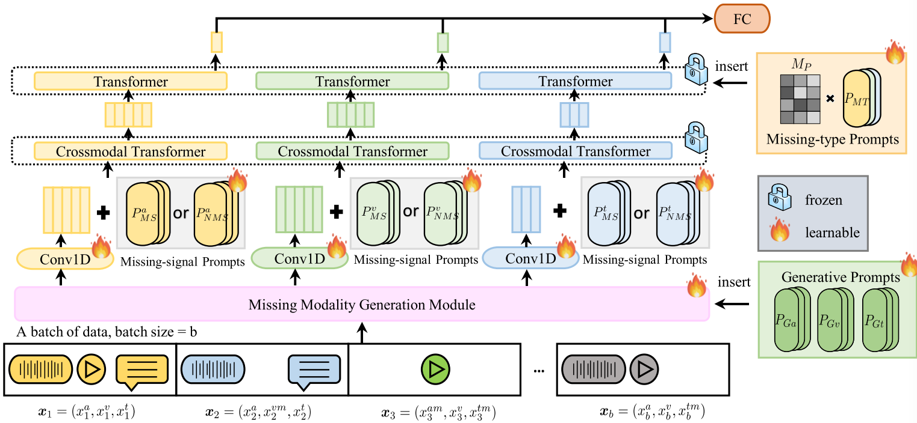

Slide 4

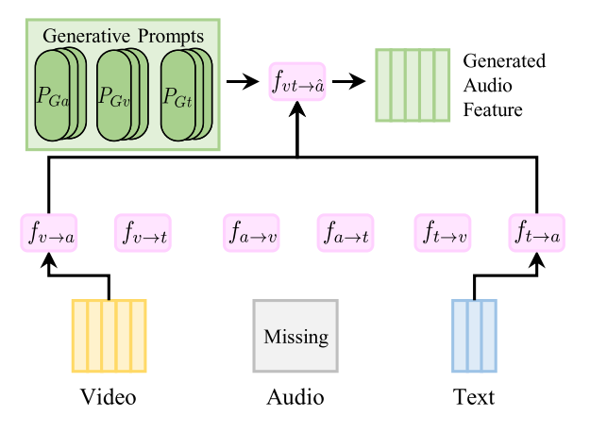




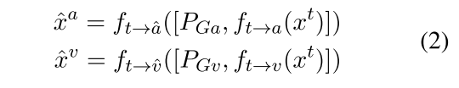


Slide 5
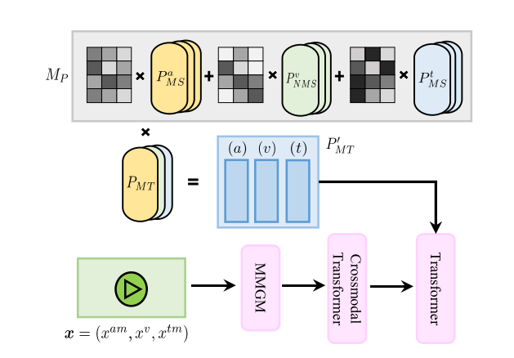

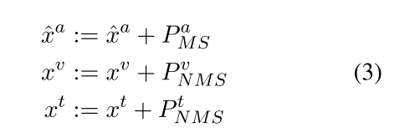




Slide 6

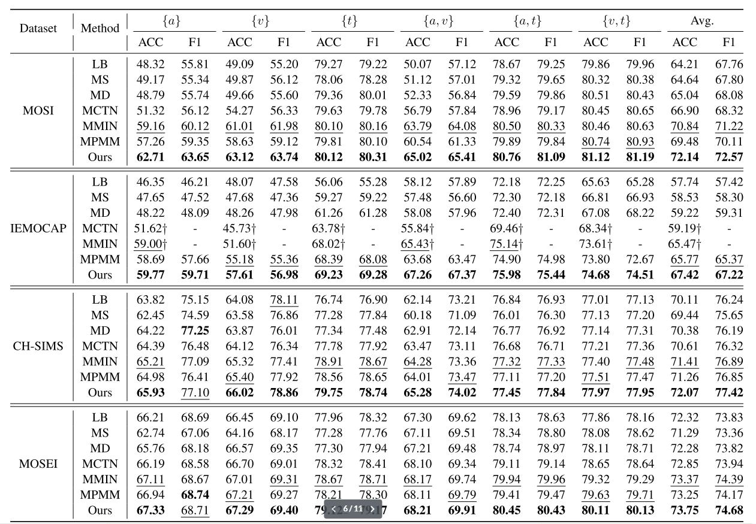

Slide 7

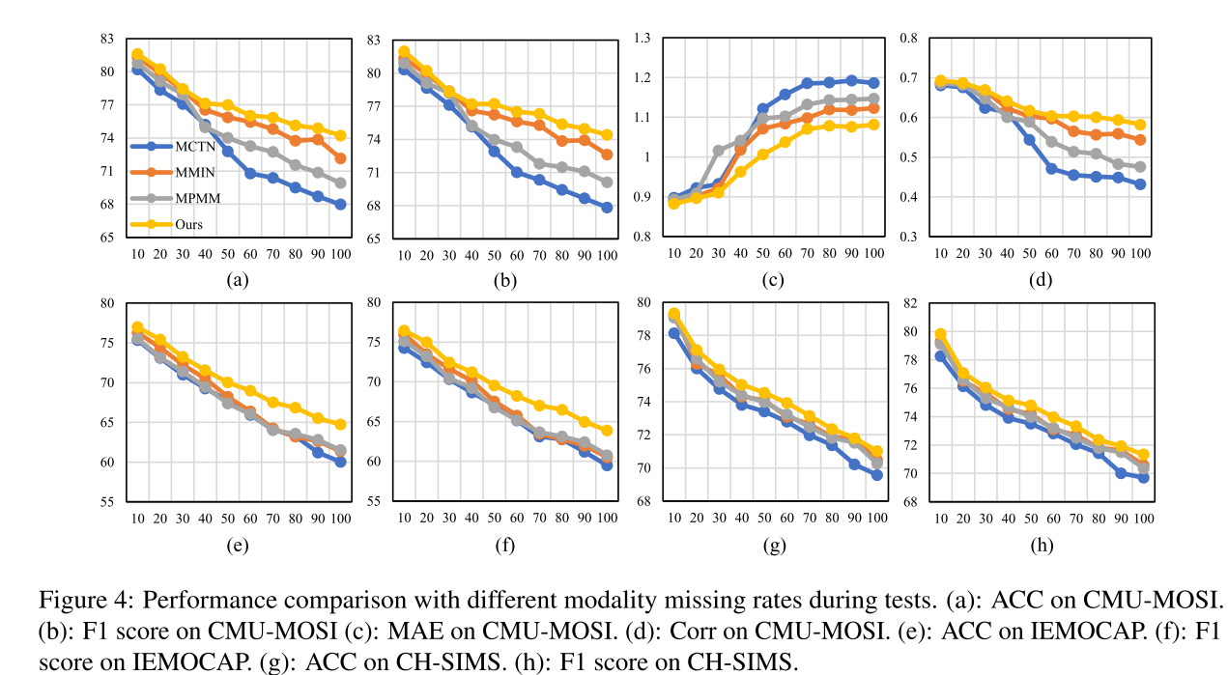

Slide 8

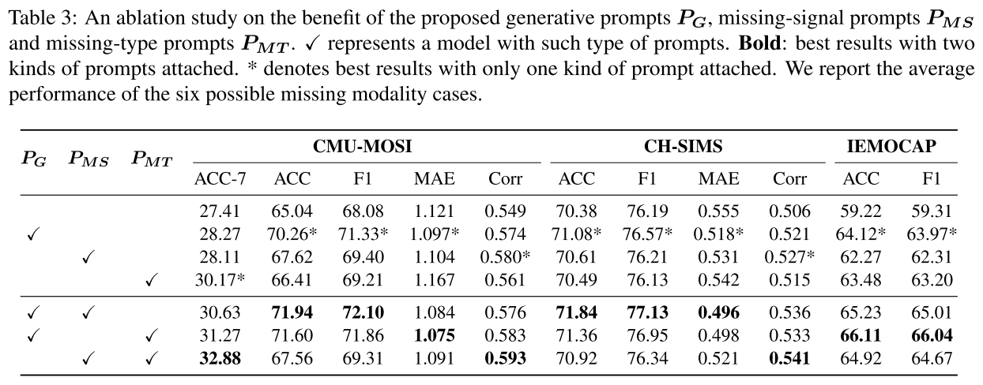

Slide 9
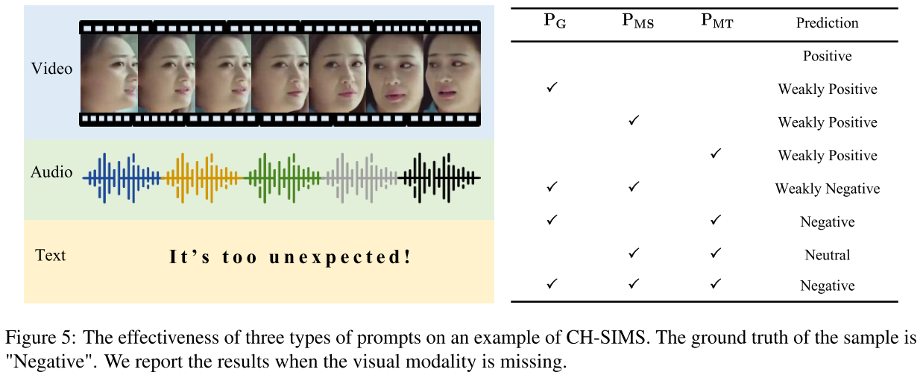

Slide 10

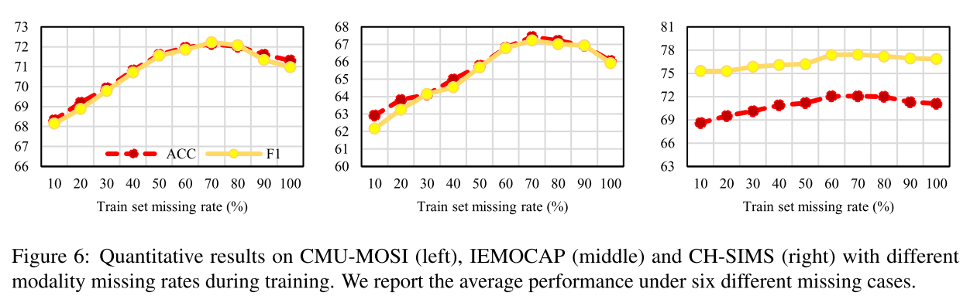

Slide 11

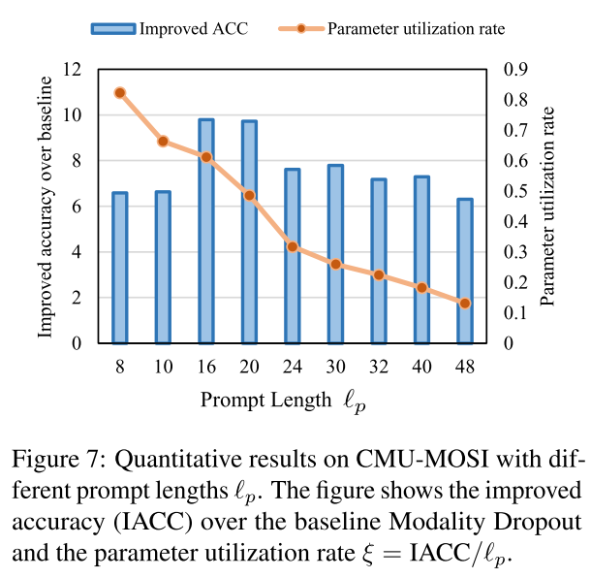

Slide 12
Thanks!

